Slide 1
Digital Logic
Chapter 2
Digital Principles and Applications
Donald P Leach, Albert Paul Malvino and Goutam Saha
Course Instructor :Dr. Kavitha Sooda, Associate Professor, Dept. of CSE, BMSCE, Bengalure

Slide 2
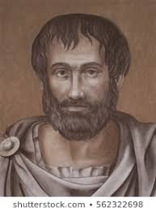
Two state Logic
Is the action right or wrong?
A motive good or bad?
A conclusion true or false?

Slide 3
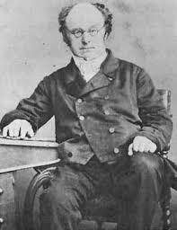
Link between logic and Mathematics

Slide 4
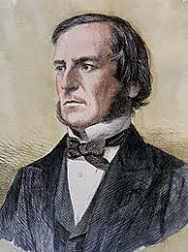
Boolean Algebra

Slide 5
Objective
What is gate?
Basic gates with symbols
Writing Boolean equations for logic circuits and drawing logic circuit
Using DeMorgan’s first and second theorems to create equivalent circuits
Understand the operation of AND-OR-INVERT gates and expanders

Slide 6
What is gate?
Digital Circuit having
one or more input signals
but only one output single

Slide 7

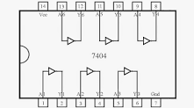
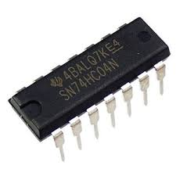
Basic Gates
Inverter

Slide 8
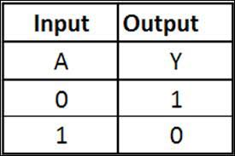
Truth Table for Not Gate
Input | Output
A | Y
L | H
H | L

Slide 9
Waveform for Not Gate
A 1-kHz square wave drives pin 1 of a 7404. What does the voltage waveform at pin 2 look like?
Two state operation
Positive logic
What is the Boolean Logic for Not Gate?

Slide 10
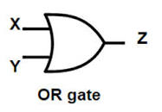
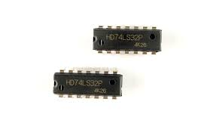
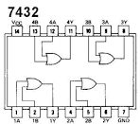
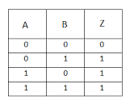
OR Gate - 7432

Slide 11
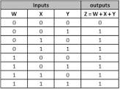
3-input OR gate

Slide 12
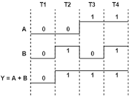
Timing Diagram
Boolean Equation of OR Gate ?

Slide 13
AND Gate – Class Assignment
Two-input AND Gate
Truth Table for 2 input and 3 input
Pinout diagram of AND gate
Timing Diagram
Boolean Equation

Slide 14
Self Test
What is a transistor?
What is TTL?
A system in which H=1 and L=0 is which Logic? (Positive or negative)
A gate whose output is H if any input is H is an ______ gate.
A gate whose output is H only when all inputs are H is an ________ gate.
Why ground is required in all circuits?

Slide 15
Home work
Invert the truth table output of OR gate and AND Gate? (where to invert???) and write the truth table.

Slide 16
End of class
Writing Boolean equations
Universal Logic Gates – NOR , NAND

